Slide 1


Slide 2
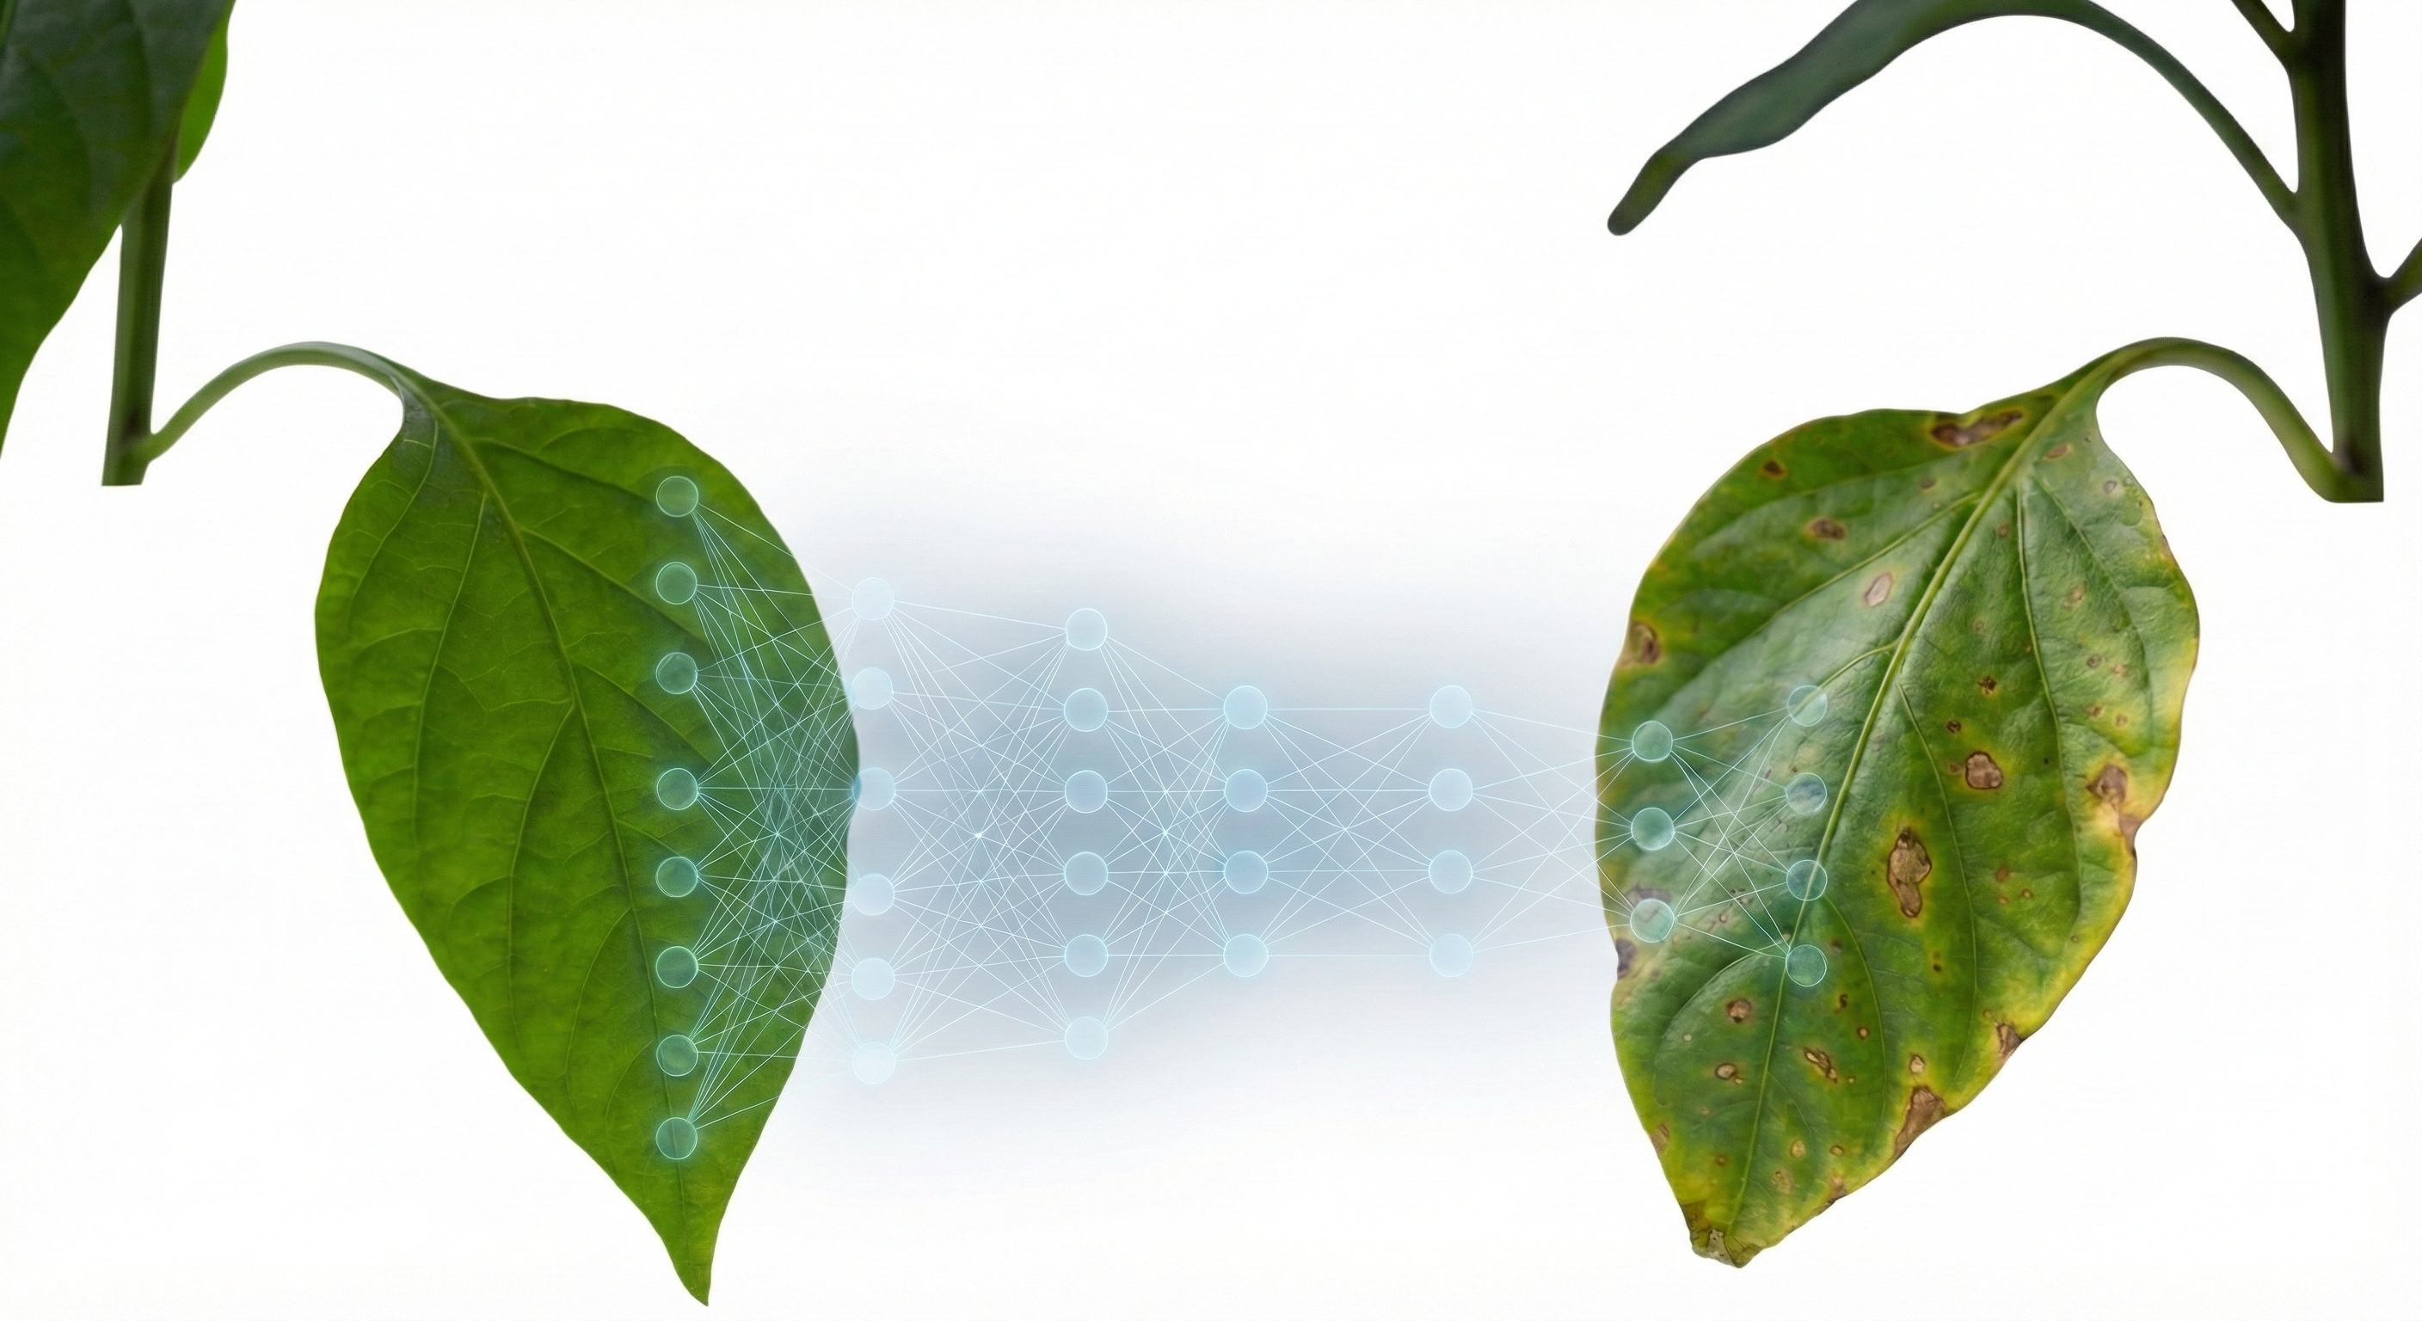
LIGHTWEIGHT CNN FOR PLANT DISEASE DETECTION: TRANSFER LEARNING AND XAI
February 05, 2026

Slide 3
OUR TEAM
ID | NAME | INATAKE | SECTION
21222203005 | MD. NAJMUL PARVES | 41 | 01
21222203017 | MD. ABDULLAH AL MAMUN | 41 | 01
21222203029 | SAGAR SAHA | 41 | 01
21222203031 | AKTARUZZAMAN | 41 | 01
21222203037 | SIAM HOSSAIN | 41 | 01

Slide 4
SUPERVISED BY
MD. SHAHIDUZZAMAN
ASSISTANT PROFESSOR
DEPARTMENT OF COMPUTER SCIENCE & ENGINEERING
BANGLADESH UNIVERSITY OF BUSINESS AND TECHNOLOGY (BUBT)

Slide 5
OVERVIEW
Introduction
Problem Statement
Literature Review
Research Objectives
Dataset
Methodology
Results
Model Comparison
Explainable AI
Web App Demo
Future Work
Conclusion

Slide 6
Introduction
Overview of Plant Disease?
A plant disease is a physiological disorder or abnormality that alters the normal structure and function of a plant. It stops the plant from performing to its maximum potential, leading to:
Reduced Yield: Lower production of fruits, vegetables, or grains.
Poor Quality: Aesthetic damage (spots, wilting) making produce unmarketable.
Economic Loss: Significant financial loss for farmers and threats to global food security.

Slide 7
Introduction
These diseases are primarily caused by pathogens such as:
Fungi: (e.g., Late Blight, Black Rot)
Bacteria: (e.g., Bacterial Spot)
Viruses: (e.g., Yellow Leaf Curl Virus)

Slide 8
Problem Statement
Manual Diagnosis Limitations:
Time-consuming, subjective, and prone to human error.
Scarcity of experts in remote agricultural areas.
Computational Constraints:
High accuracy models (e.g., ResNet50) are too heavy for mobile devices.
High memory usage and slow inference speed.

Slide 9
Problem Statement
The "Black Box" Issue:
Lack of transparency in Deep Learning models.
Farmers distrust "unexplained" predictions.
Accuracy vs. Efficiency Gap:
Existing lightweight models often sacrifice accuracy for speed.

Slide 10
Literature Review
Existing Approaches:
Mohanty et al. (2016): Used AlexNet/GoogLeNet. High accuracy (99.35%) but struggled with generalization [1].
Ferentinos (2018): Used VGG16. Best accuracy (99.53%) but computationally very expensive (138M params) [2].
MobileNet Studies: Focused on speed but often sacrificed accuracy on fine-grained diseases [3].

Slide 11
Literature Review
Limitations in Literature:
Heavy models (ResNet/VGG) are unsuitable for mobile apps.
Lack of Explainability (XAI) – most works are "Black Boxes."
How Our Work is Different (Novelty):
Optimal Balance: Proposed Custom CNN matches ResNet accuracy but is 12x smaller.
Transparency: Integrated Grad-CAM to visually validate the model's focus (lesions vs. background).
Efficiency: Surpassed MobileNetV2 in accuracy while remaining lightweight (7.6 MB).

Slide 12
Research Objectives
To develop a Custom Lightweight CNN optimized for leaf disease classification.
To implement Transfer Learning using ResNet50 and MobileNetV2 for comparative analysis.
To validate model transparency using Explainable AI (Grad-CAM).
To deploy the best model via a user-friendly Web Application.

Slide 13
Dataset
Source: PlantVillage Dataset (Open Access).
Total Images: 54,305 images.
Classes: 38 distinct classes (Disease + Healthy).
Crop Species: 14 different plants.
Environment: Controlled laboratory settings (Uniform background).

Slide 14
Dataset
List of 14 Crop Species:
Apple | Blueberry
Cherry | Corn (Maize)
Tomato | Grape
Orange | Peach
Pepper (Bell) | Potato
Raspberry | Soybean
Squash | Strawberry

Slide 15
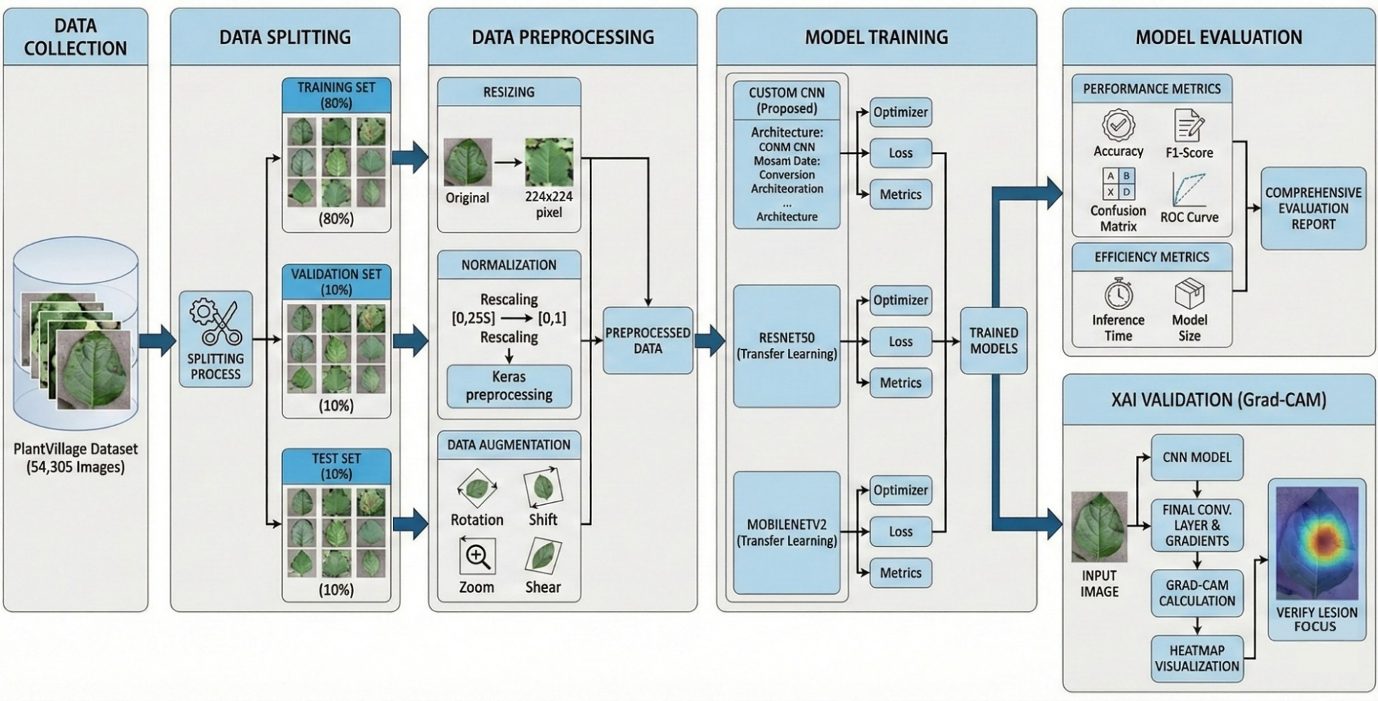
Methodology

Slide 16
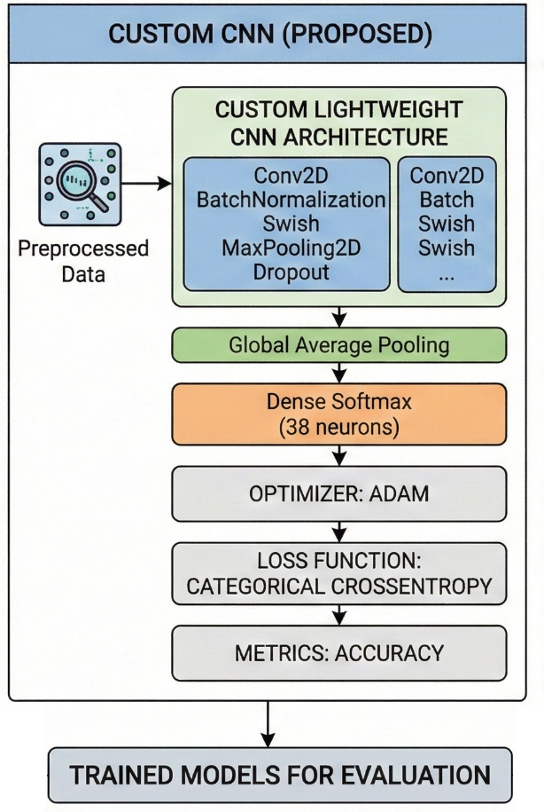
Proposed CNN Architecture

Slide 17
Proposed CNN Architecture
Key Specifications:
Input Shape: 224 * 224 * 3 (RGB Images)
Total Parameters: 652,198 (approx. 0.65 Million)
Structure: 3 Convolutional Blocks + Classification Head
Regularization: Batch Normalization & Dropout (0.25 - 0.5)

Slide 18
CNN Layer Configuration Summary:
Block | Layer Type | Filters / Units | Output Shape | Function
Input | Input Layer | - | (224, 224, 3) | Image Entry
Block 1 | 2x Conv2D + MaxPool | 32 → 64 | (112, 112, 64) | Low-level Features (Edges)
Block 2 | 2x Conv2D + MaxPool | 64 → 128 | (56, 56, 128) | Mid-level Features (Textures)
Block 3 | 2x Conv2D + MaxPool | 128 → 256 | (28, 28, 256) | High-level Features (Patterns)
Head | Global Avg Pooling | - | (256) | Dimensionality Reduction
Output | Dense (Softmax) | 38 | (38) | 38-Class Classification

Slide 19
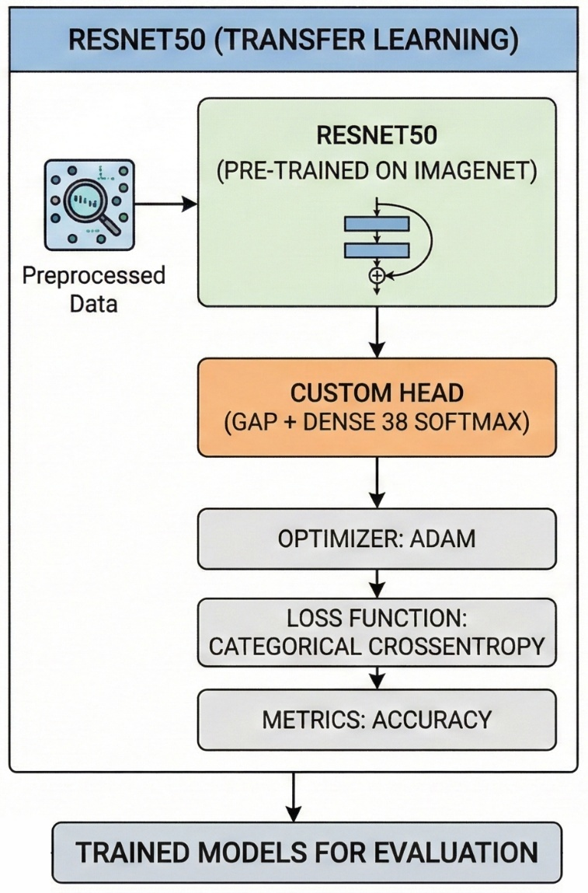
Transfer Learning with ResNet50

Slide 20
Transfer Learning with ResNet50
Model Strategy:
Base Model: ResNet50 pre-trained on ImageNet (Weights Frozen).
Custom Classification Head: Added to fit our 38 classes.
Custom Head Configuration:
Global Average Pooling: Vectorizes feature maps.
Dense Layer (256): With Swish activation & Batch Normalization.
Dropout (0.5): To prevent overfitting.
Output Layer: 38 Neurons (Softmax).

Slide 21
Parameter Summary:
Parameter Type | Count | Implication
Total Parameters | 24,123,046 | Deep feature extraction capability.
Non-Trainable | 23,588,224 | Frozen ImageNet weights (Base).
Trainable | 534,822 | Only the Custom Head is trained.

Slide 22
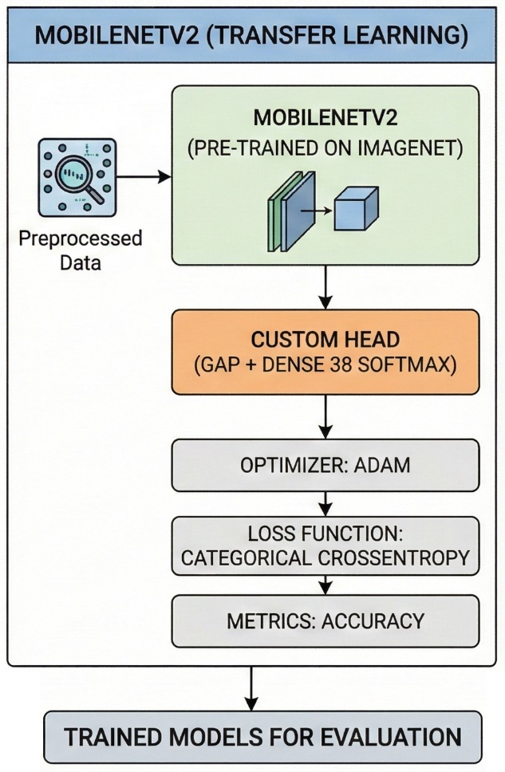
MobileNetV2 Architecture

Slide 23
MobileNetV2 Architecture
Model Strategy:
Pipeline: Standard Transfer Learning.
Base: MobileNetV2 (Pre-trained on ImageNet, Frozen).
Head: Custom Classification Head (GAP → Dense → Dropout → Softmax).
Parameter Efficiency (The Advantage):
Total Parameters: ~2.6 Million (10x smaller than ResNet50).
Target Use Case: Highly suitable for Smartphones & Edge Devices.

Slide 24
MobileNetV2 Architecture
Configuration Summary:
Component | Specification / Count
Input Shape | (224, 224, 3)
Custom Head | GAP → Dense(256) → Dropout(0.5) → Output(38)
Total Params | 2,596,710 (~2.6 M)
Trainable | 338,214 (Head Only)
Non-Trainable | 2,258,496 (Frozen Base)

Slide 25
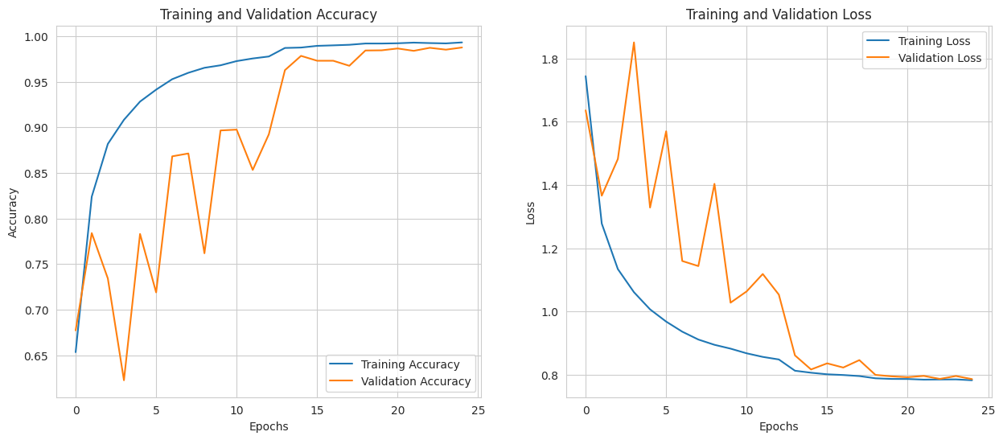
Result(Custom CNN)

Slide 26
Result(Custom CNN)
Performance:
Test Accuracy: 98.71% (Highest among all).
Loss: 0.7809
Observation
Rapid convergence.
Minimal gap between Training and Validation accuracy (No overfitting).

Slide 27
Classification Report(Test Set)
Metric | Score
Accuracy | 99%
Macro Average (Precision) | 99%
Macro Average (Recall) | 99%
Macro Average (F1-Score) | 99%
Weighted Average F1-Score | 0.99

Slide 28
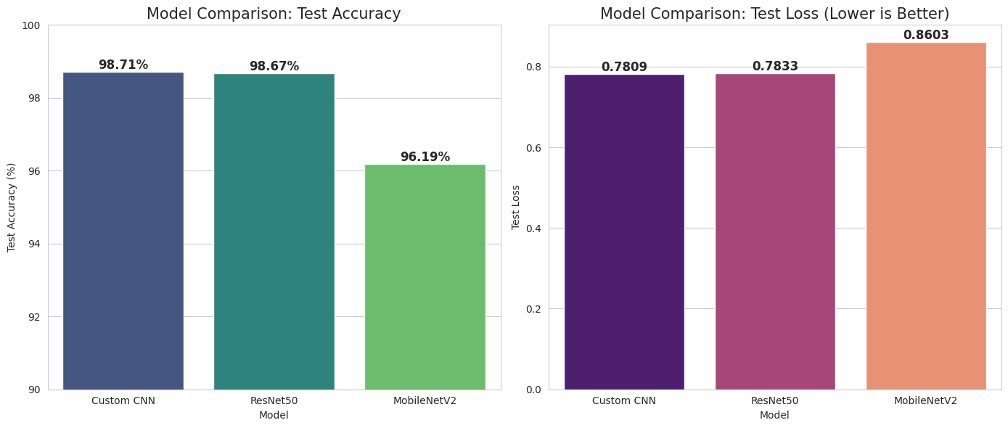
Model Comparison

Slide 29
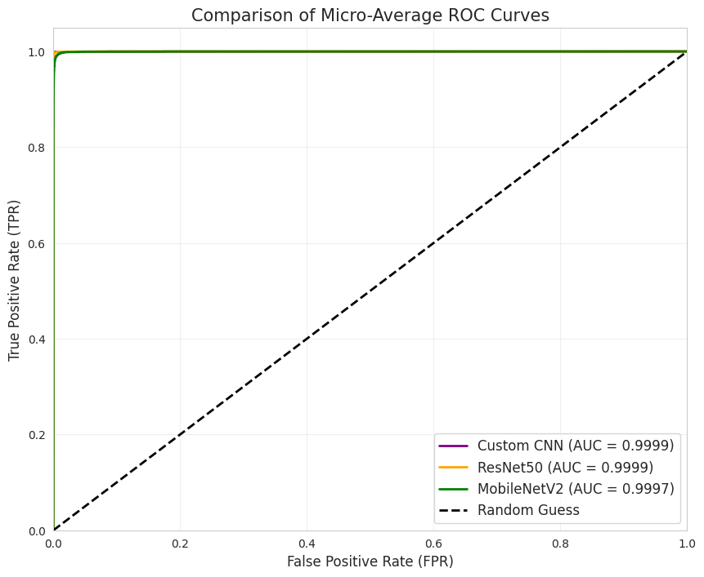
Model Comparison

Slide 30
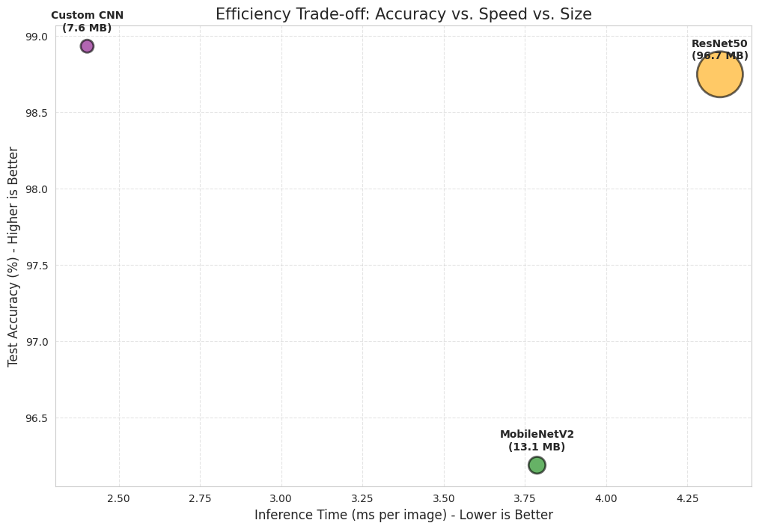
Model Comparison

Slide 31
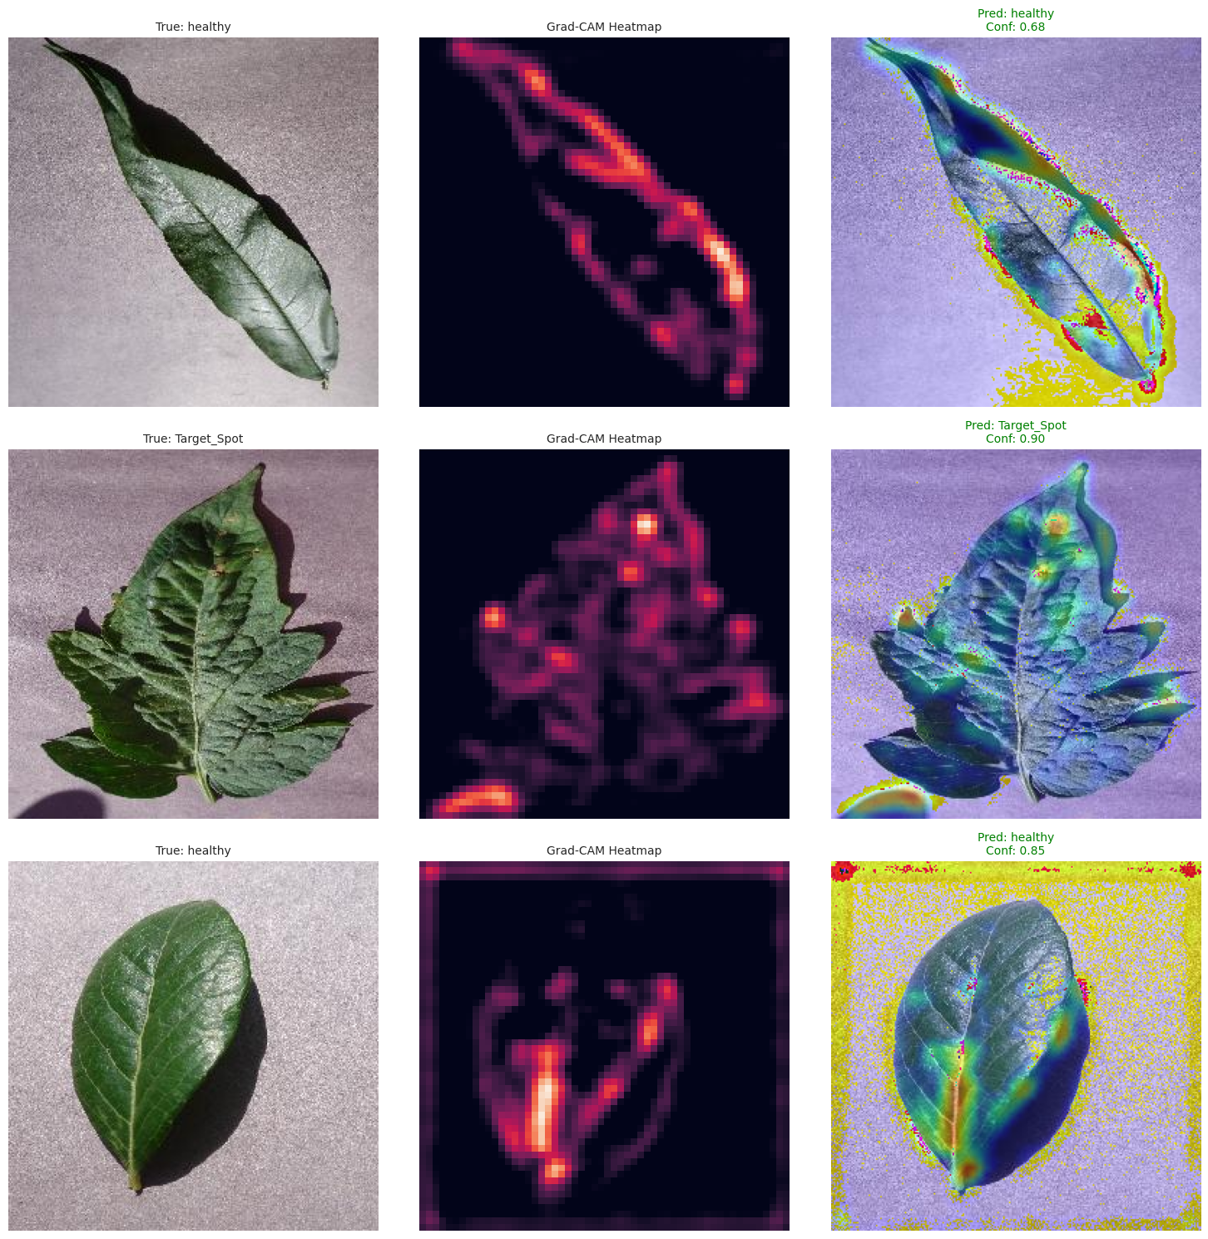
Explainable AI (Grad-CAM Validation)

Slide 32
Implementation (Web App Demo)
Streamlit APP
Tools: Python, Streamlit, TensorFlow.
Features:
Real-time Image Upload.
Instant Prediction with Confidence Score.
"Healthy" vs "Disease" visual alerts.

Slide 33
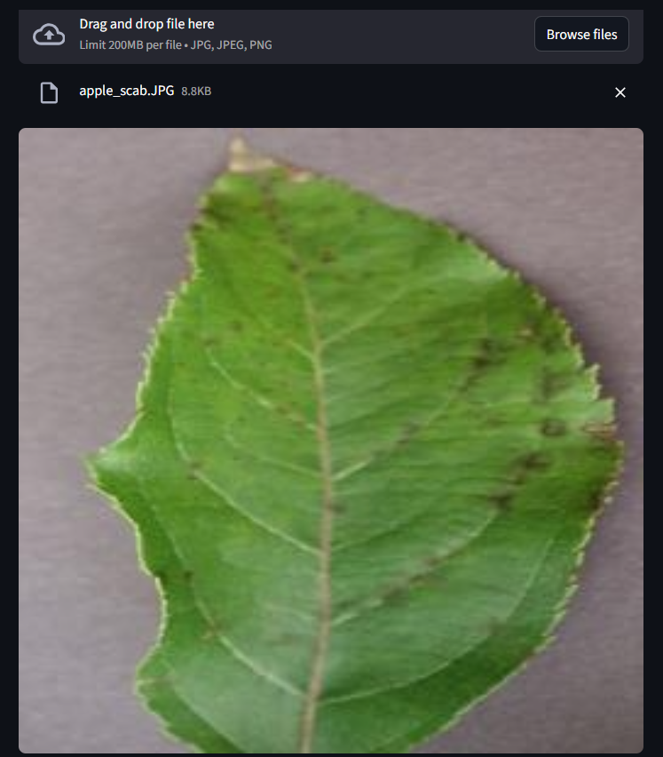
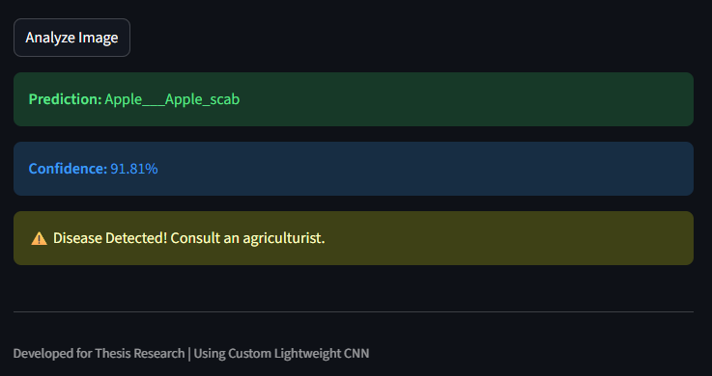

Slide 34
Conclusion
Developed a highly efficient CNN model (98.71% Accuracy).
Outperformed MobileNetV2 and matched ResNet50 while being significantly lighter (7.6 MB).
Validated reliability using Grad-CAM.
Ready for deployment on edge devices/smartphones for farmers.

Slide 35
Future Work
Mobile App: Convert to TFLite for offline Android App.
Real-field Data: Collect images from local Bangladeshi fields to handle complex backgrounds.
Recommendation System: Suggest fertilizers/medicines based on detection.

Slide 36
References
[1] D. P. Hughes and M. Salathé, "An open access repository of images on plant health," arXiv preprint, 2015.
[2] S. P. Mohanty et al., "Using deep learning for image-based plant disease detection," Frontiers in Plant Science, 2016.
[3] K. He et al., "Deep residual learning for image recognition (ResNet)," IEEE CVPR, 2016.
[4] M. Sandler et al., "MobileNetV2: Inverted residuals and linear bottlenecks," IEEE CVPR, 2018.
[5] K. P. Ferentinos, "Deep learning models for plant disease detection and diagnosis," Computers and Electronics in Agriculture, 2018.
[6] R. R. Selvaraju et al., "Grad-CAM: Visual explanations from deep networks," IEEE ICCV, 2017.

Slide 37

For your attention

Slide 38

21222203031@cse.bubt.edu.bd

